Slide 1
IoT Attack and Security Analysis in Edge Computing Network

Slide 2
Introduction and Problem Statement
The rapid growth of IoT devices has increased security concerns, especially in edge computing environments.
Edge computing enhances efficiency but is highly vulnerable to cyber threats like: 1. Unauthorized access 2. Data breaches 3. Device manipulation
This project proposes a real-time IoT attack detection framework using Machine Learning techniques.

Slide 3
Solution
This project focuses on detecting and mitigating IoT attacks using an Attack Detectable IoT System integrated with: 1. Smart Environmental Monitoring Sensor 2. Smart Bulb 3. Buzzer
The system addresses four major cyber threats: 1. Denial of Service (DoS) 2. Command & Control (C&C) 3. PartOfAHorizontalPortScan 4. FileDownload
Machine Learning based Attack Detection is implemented, with XGBoost achieving 94.85% accuracy, making it the preferred model.

Slide 4
Objectives
To ensure secure integration and control of a Smart Environmental Monitoring sensor for environmental data collection and a Smart Bulb for actuation
To integrate with end-user environment, with visualization, monitoring control features and to enable automatic alerting
To simulate and analyze different attack scenarios, such as Command and Control (C&C), PartOfAHorizontalPortScan, FileDownload and Denial of Service (DoS)
To implement attack detections using machine learning models, focusing on detecting unauthorized access and malicious activity in the network
To develop an Attack Detectable IoT System

Slide 5
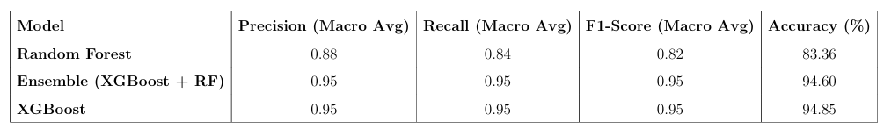
Results
Comparison of Machine Learning Models

Slide 6
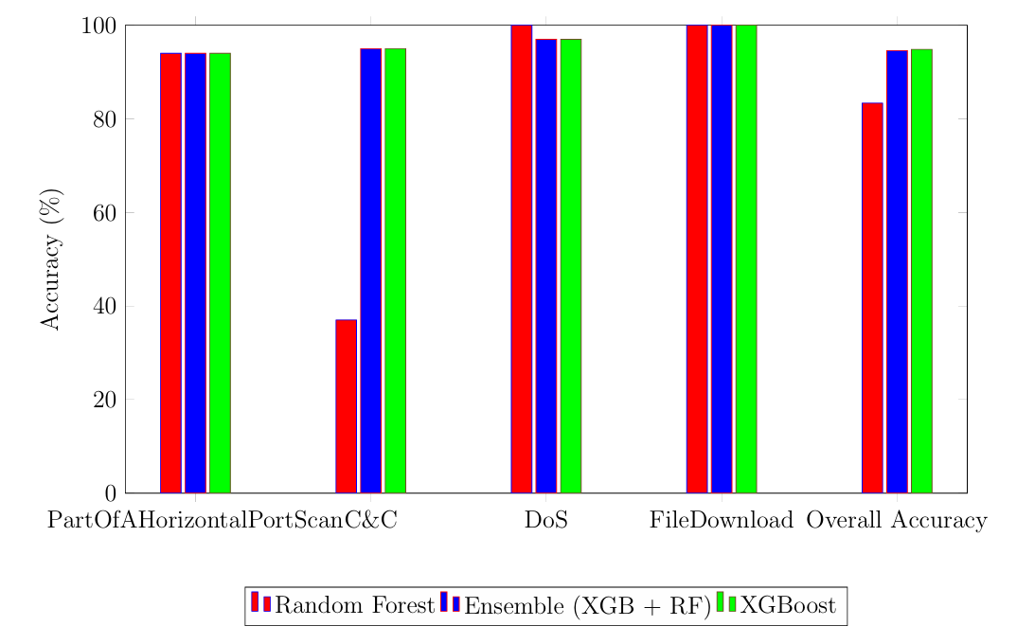
Results
Performance Comparison for IoT Attack Detection

Slide 7
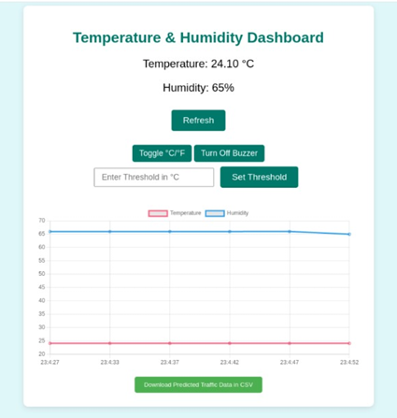

Dashboards

Slide 8
Hardware Technologies
Raspberry Pi 4 Model B
DHT11 Sensor
LED
Buzzer

Slide 9
Software Technologies
Operating Systems:
Raspberry Pi OS
Kali Linux
Programming Environment:
Python
Numpy
Scikit-Learn
Rpi.GPIO
Matplotlib
Web Framework:
Flask

Slide 10
Software Technologies
Front-End Web Development:
HTML
CSS
JavaScript
Network Monitoring Tool:
tcpdump
Machine Learning Models Used:
Random Forest
Ensemble
XGBoost

Slide 11
Conclusion
The Attack Detectable IoT System integrates Smart Environmental Monitoring Sensors and Smart Bulbs with a web interface for real-time monitoring and attack management.
XGBoost model (94.85% accuracy) outperformed other models, making it the preferred choice for attack classification.
Real-time network traffic captured using tcpdump demonstrating real-world applicability.
Detected unauthorized access and providing real-time attack logs for proactive threat management.

Slide 12
References
Wang et al., “A Lightweight, Privacy-Preserving Ciphertext Retrieval Scheme Inte grating Edge Computing for Enhanced Security and Efficiency in IoT Environments,” Journal of Cloud and IoT Security, 2024.
Keshary et al., “Addressing Security Challenges in IoT Devices with Advanced Certi f ication Processes,” IoT Security Review, 2024.
Maghrabi, “A Machine Learning-Based Network Intrusion Detection System Using Random Forest for IoT Security,” IoT Network Protection Journal, 2024.
Singh et al., “Hierarchical Security Paradigm with Software-Defined Perimeter in MEC for IoT Devices,” Edge Computing Security Research, 2021.
Sadhwani et al., “Machine Learning and Deep Learning Techniques for Cyber Threat Classification in Industrial IoT,” Industrial IoT Security Advances, 2024.

Slide 13
Thank You!

